Slide 1
Creepiness Metric and LSTM
Anthony
11/16/2020

Slide 2
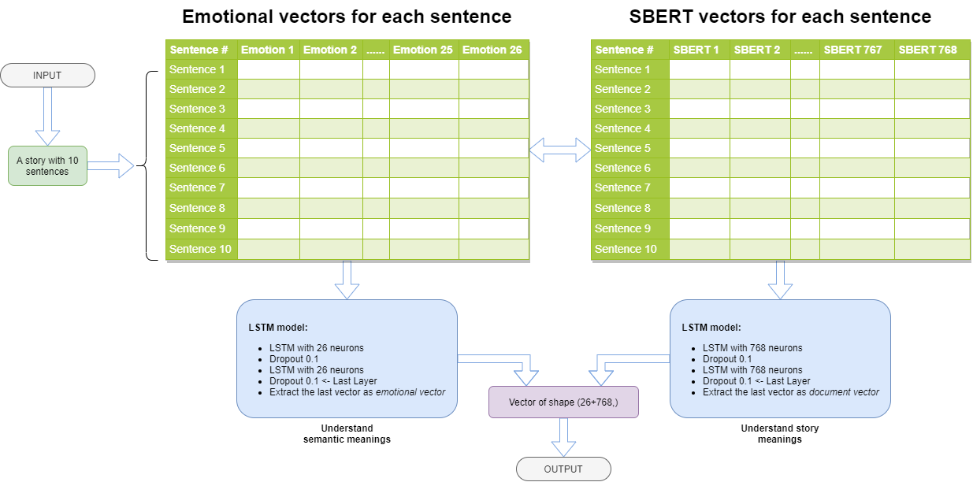
Or average all LSTM vectors
Or average all LSTM vectors

Slide 3
How do we know what emotions to choose from?
“Self-report captures 27 distinct categories of emotion bridged by continuous gradients” by Alan S. Cowen and Dacher Keltner in September 2017
https://www.pnas.org/content/114/38/E7900
https://s3-us-west-1.amazonaws.com/emogifs/map.html#
Their results were discovered after gathered 2,185 short videos showing a wide variety of situations and events, including a man with a spider in his mouth, a cat giving a dog a massage and an awkward handshake. The videos were chosen to provoke particular emotions from more than 800 participating viewers.
27 emotions: admiration, adoration, aesthetic appreciation, amusement, anger, anxiety, awe, awkwardness, boredom, calmness, confusion, craving, disgust, empathic pain, entrancement, excitement, fear, horror, interest, joy, nostalgia, relief, romance, sadness, satisfaction, sexual desire, surprise
Cosine similarity between emotions and sentences

Slide 4
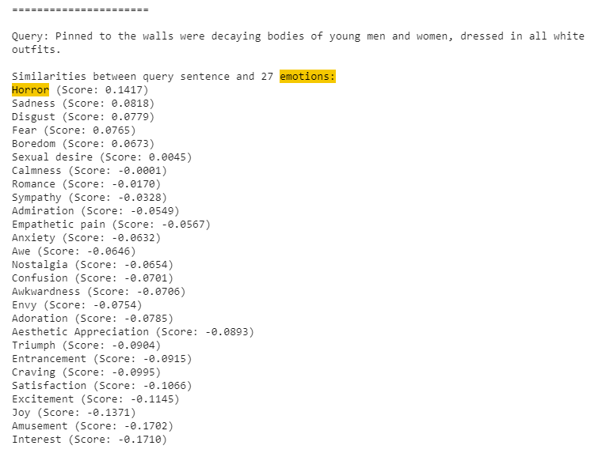
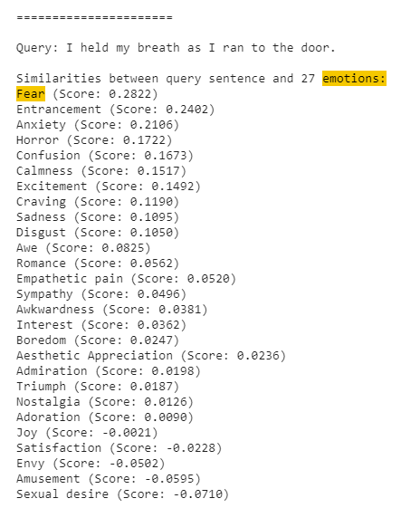

Slide 5
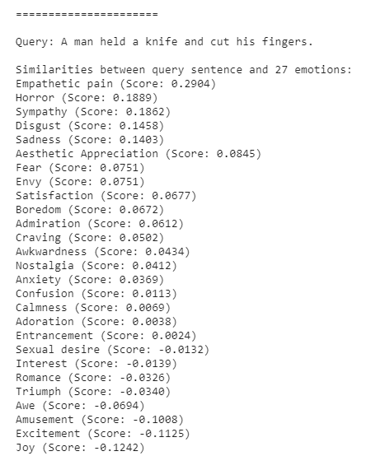
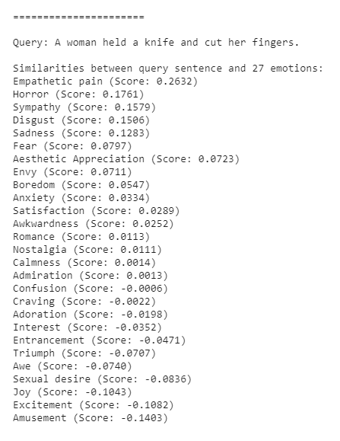
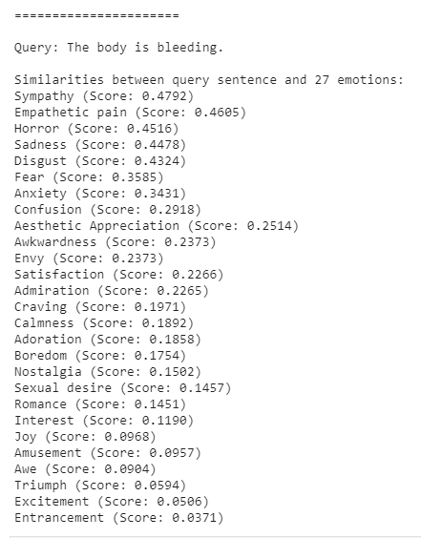

Slide 6
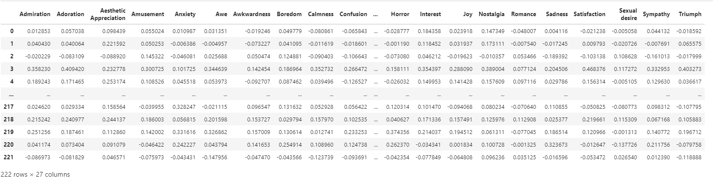

Slide 7
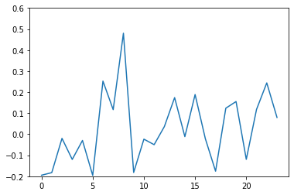
Horror level across a story
A story from confessions with 24 sentences
The most upvoted story in the dataset

Slide 8
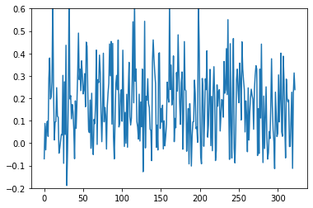
Horror level across a story
A story from nosleep with 303 sentences
The most upvoted story in the dataset

Slide 9
sentences of a story
A story from confessions with 24 sentences
The most upvoted story in the dataset

Slide 10
sentences of a story
A story from nosleep with 303 sentences
The most upvoted story in the dataset

Slide 11
Or average all LSTM vectors
Or average all LSTM vectors

Slide 12
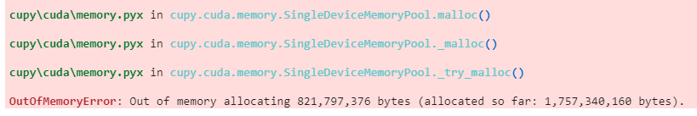
Problems
HUGE memory consumptions
I have 16G of RAM and 8G of VRAM
0.821797376 Gigabytes
1.75734016 Gigabyte

